Slide 1
Angular CLI
Building and Serving
Lecture 6
By James(Jin) Wang
09/28/2019

Slide 2
Outline
Building with the Angular CLI
Build targets
Exploring the builds
Serving
Development cycle

Slide 3
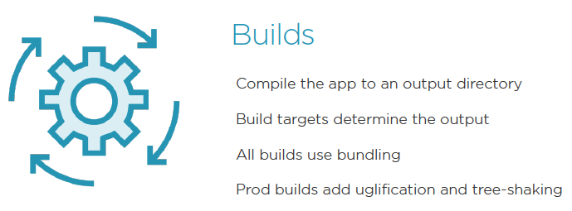
Building Angular

Slide 4
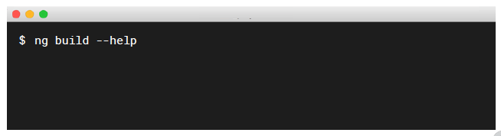
Building Angular
  Getting Help:
  Add the --help flag

Slide 5
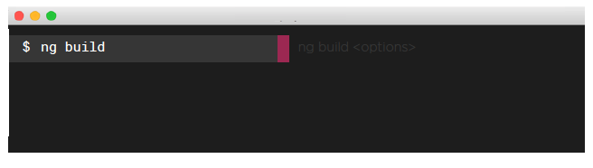
Building Angular
  Development Builds:
  Ideal for development
  Output to /dist/[your app] folder, by default

Slide 6
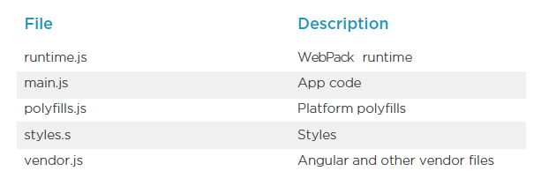
Building Angular
  Exploring the Build Bundles:

Slide 7
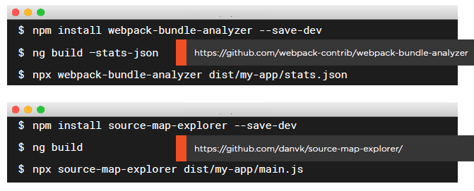
Building Angular
  Exploring the Source in the Output:

Slide 8
Demo
  ng build
  npm install webpack-bundle-analyzer --save-dev
  ng build --stats-json
  package.json:
  "scripts": {
  "stats": "npx webpack-bundle-analyzer dist/angular-routing/stats.json",
  ng run stats

Slide 9
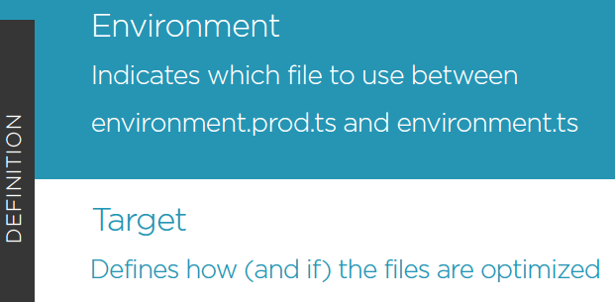
Building Targets and Environments

Slide 10
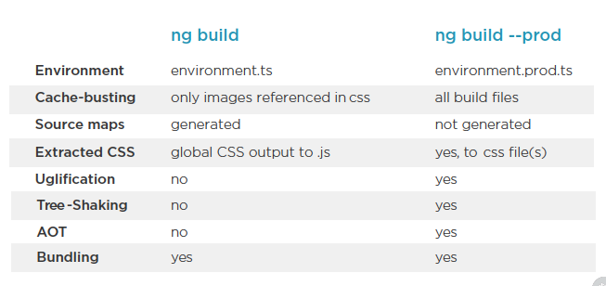
Building Targets and Environments
  Comparing Dev and Prod Build Targets:

Slide 11
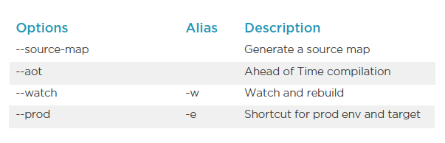
Building Targets and Environments
  Common ng build Options:

Slide 12
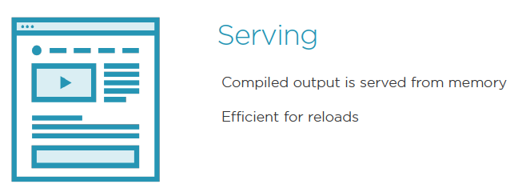
Serving Angular

Slide 13
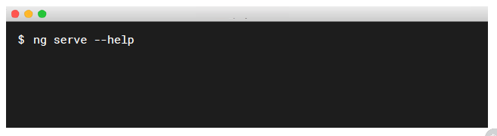
Serving Angular
  Getting Help:
  Add the --help flag

Slide 14
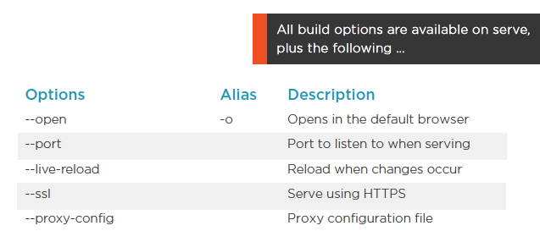
Serving Angular
  Common ng serve Options:

Slide 15
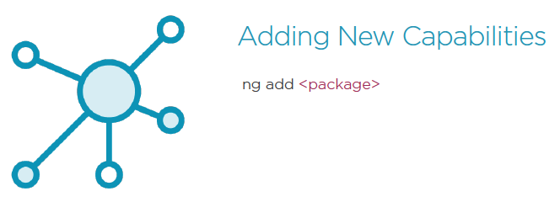
Development cycle

Slide 16
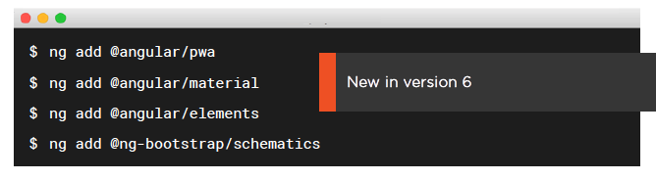
Development cycle
  nd add package:
  Adds new capabilities
  Downloads dependencies
  Update a project configuration
  Scaffold new capabilities

Slide 17
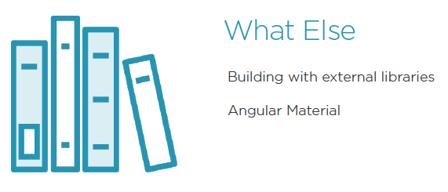
Development cycle

Slide 18
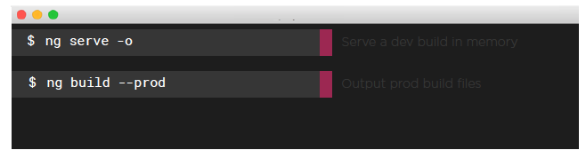
Development cycle
  Remember These Commands:
  Fast development cycles with ng serve -o
  When ready to promote your code, use ng build --prod

Slide 19
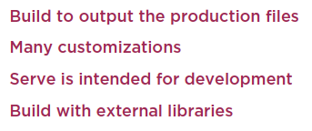
Summary

